Slide 1
DEVISING CONVERSION OF MgCl₂ TO MgCO₃

Slide 2
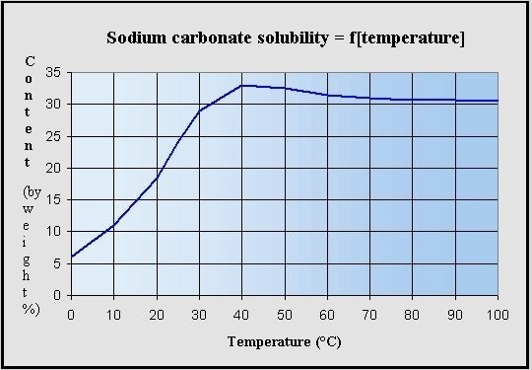

Slide 3
CONVERSION = 70%
Na2CO3(A) + MgCl2(B) -> MgCO3(C) + 2NaCl(D)
106 95 84 58.5*2
AMOUNT OF A AND B REQUIRED TO PRODUCE 4 TON OF C
IDEALLY, A = 5.048 TON
B = 4.524 TON

Slide 4
SINCE THE CONVERSION EFFECIENCY OF THE GIVEN REACTION IS 70%, THE REACTION CAN BE PUSHED TOWARD COMPLETION BY REMOVAL OF MgCO3. AFTER ONE CYCLE OF REACTION ANOTHER CYCLE CAN BE INITIATED BY REMOVING ALL THE FORMED MgCO3 AND ALLOWING THE SAME REACTION CONDITIONS AGAIN. SINCE THE CONVERSION EFFECIENCY IS FAIRLY GOOD WE CAN EXPECT NEAR COMPLETE CONVERSION OF ORIGINAL REACTANTS IN A FEW CYCLES. THEREAFTER A FRESH FEED CAN BE SUPPLIED AFTER REMOVING THE PRODUCED NaCl SOLUTION.
THIS WAY CAN PROVE TO BE MORE ECONOMICAL THAN SINGLE CYCLE REACTIONS IN WHICH THERE IS A HASSLE OF RECOVERING THE UNREACTED MgCl2 AND Na2CO3 IN PURE STATE AND RECIRCULATING THEM TO THE FEED.

Slide 5
HEAT LOST DURING PIPE FLOW
ln((T₂-T_{s})/(T₁-T_{s}))= - (π D U/m c_{p}) L
where T2=Outlet Temperature
T1=Inlet Temperature(85⁰C)
m=mass flow rate
L=Length of pipe
T_{s}=Surrounding Temperature(25⁰C)
C_{p}=Heat Capacity of solution per kilogram
Assuming 25% Na2CO3 by wt in solution
C_{p}=0.25*(112/106*1000)+0.75*(4.2*1000)
T₂=25.95⁰C

